Slide 1
Energy Outlook
John Peach with Andrii Zvorygin
28 Nov 2022

Slide 2
Outline
Does peak oil imply production midpoint?
Energy, economics and the limits to growth
The growing gap between discoveries and production
Cumulative discoveries/production and data fits
The renewable energy transition

Slide 3
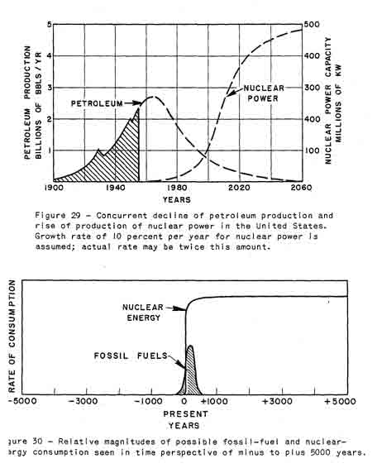
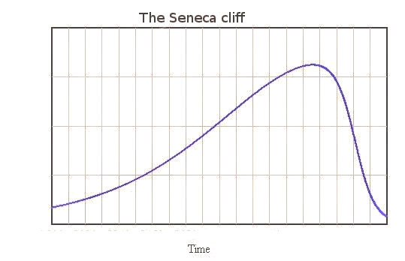
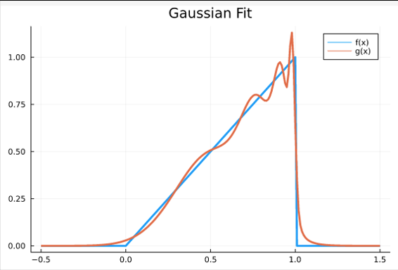
Post-peak production Seneca Cliff
Increases are of sluggish growth, but the way to ruin is rapid.
-Seneca
Hubbert noted that oil field production follows “bell curve” or Gaussian
Assumed that World production would also be Gaussian
Nuclear energy would replace fossil fuels
Ugo Bardi proposed the concept of “Seneca Cliff”
Sum of Gaussians can induce “Seneca” response
“Curve Fitting with Julia” J. Peach

Slide 4
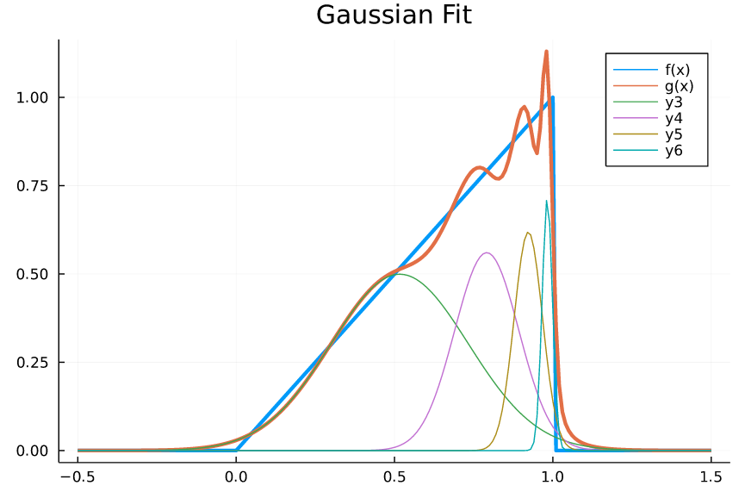
Sum of Gaussians
“U.S. shale”
Resources tend to be power law distributed:
Few large fields
Many smaller fields
“Ghawar”
Early large fields followed by many small fields lead to sharp decline

Slide 5
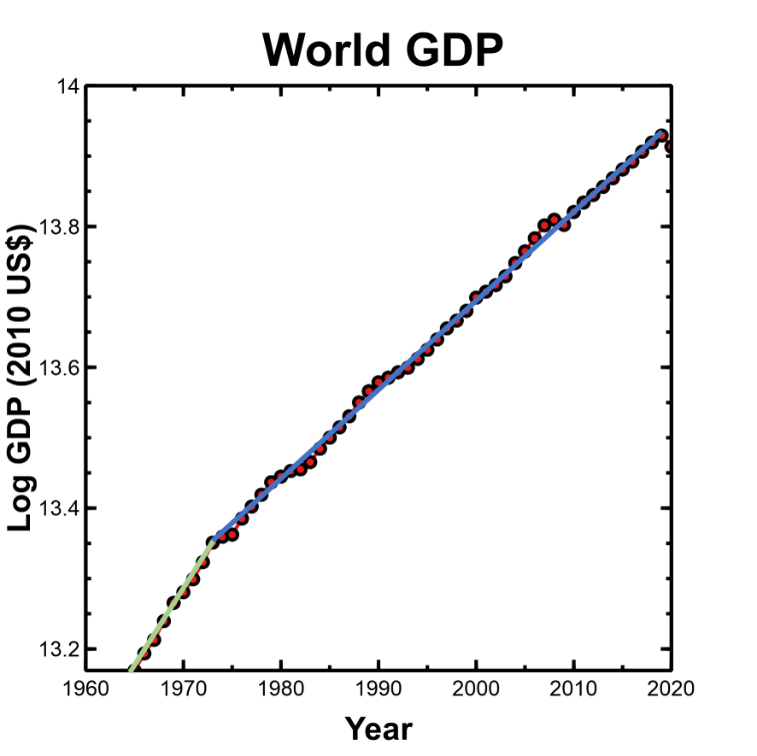
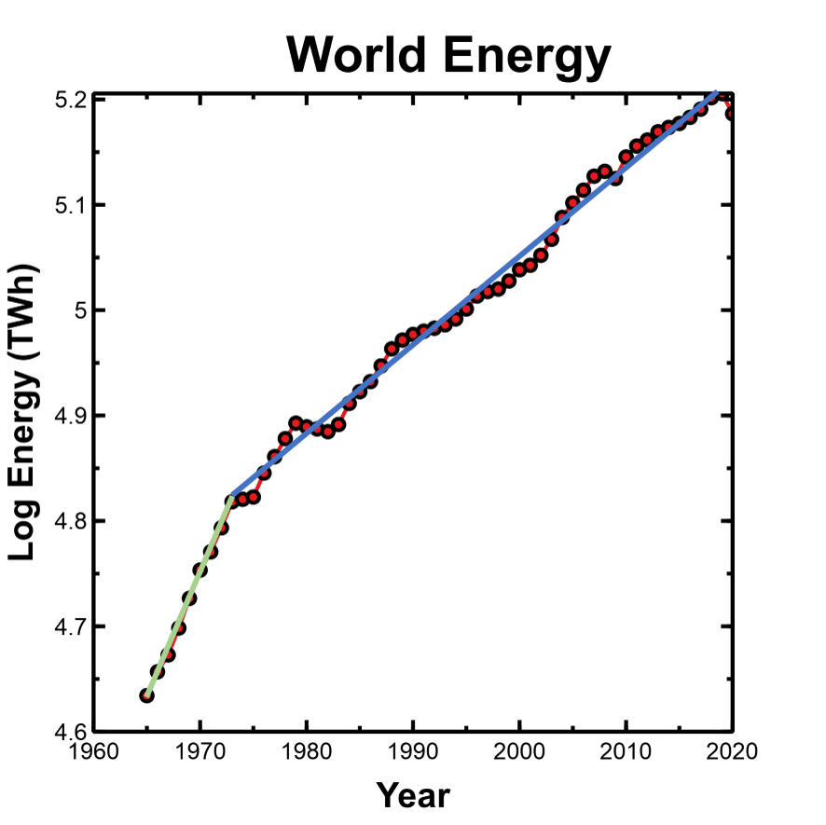
Energy and the Economy
2.9% growth/year
7.1 watts = $1000
Ref: “How persistent is civilization growth?” Garrett 2011

Slide 6
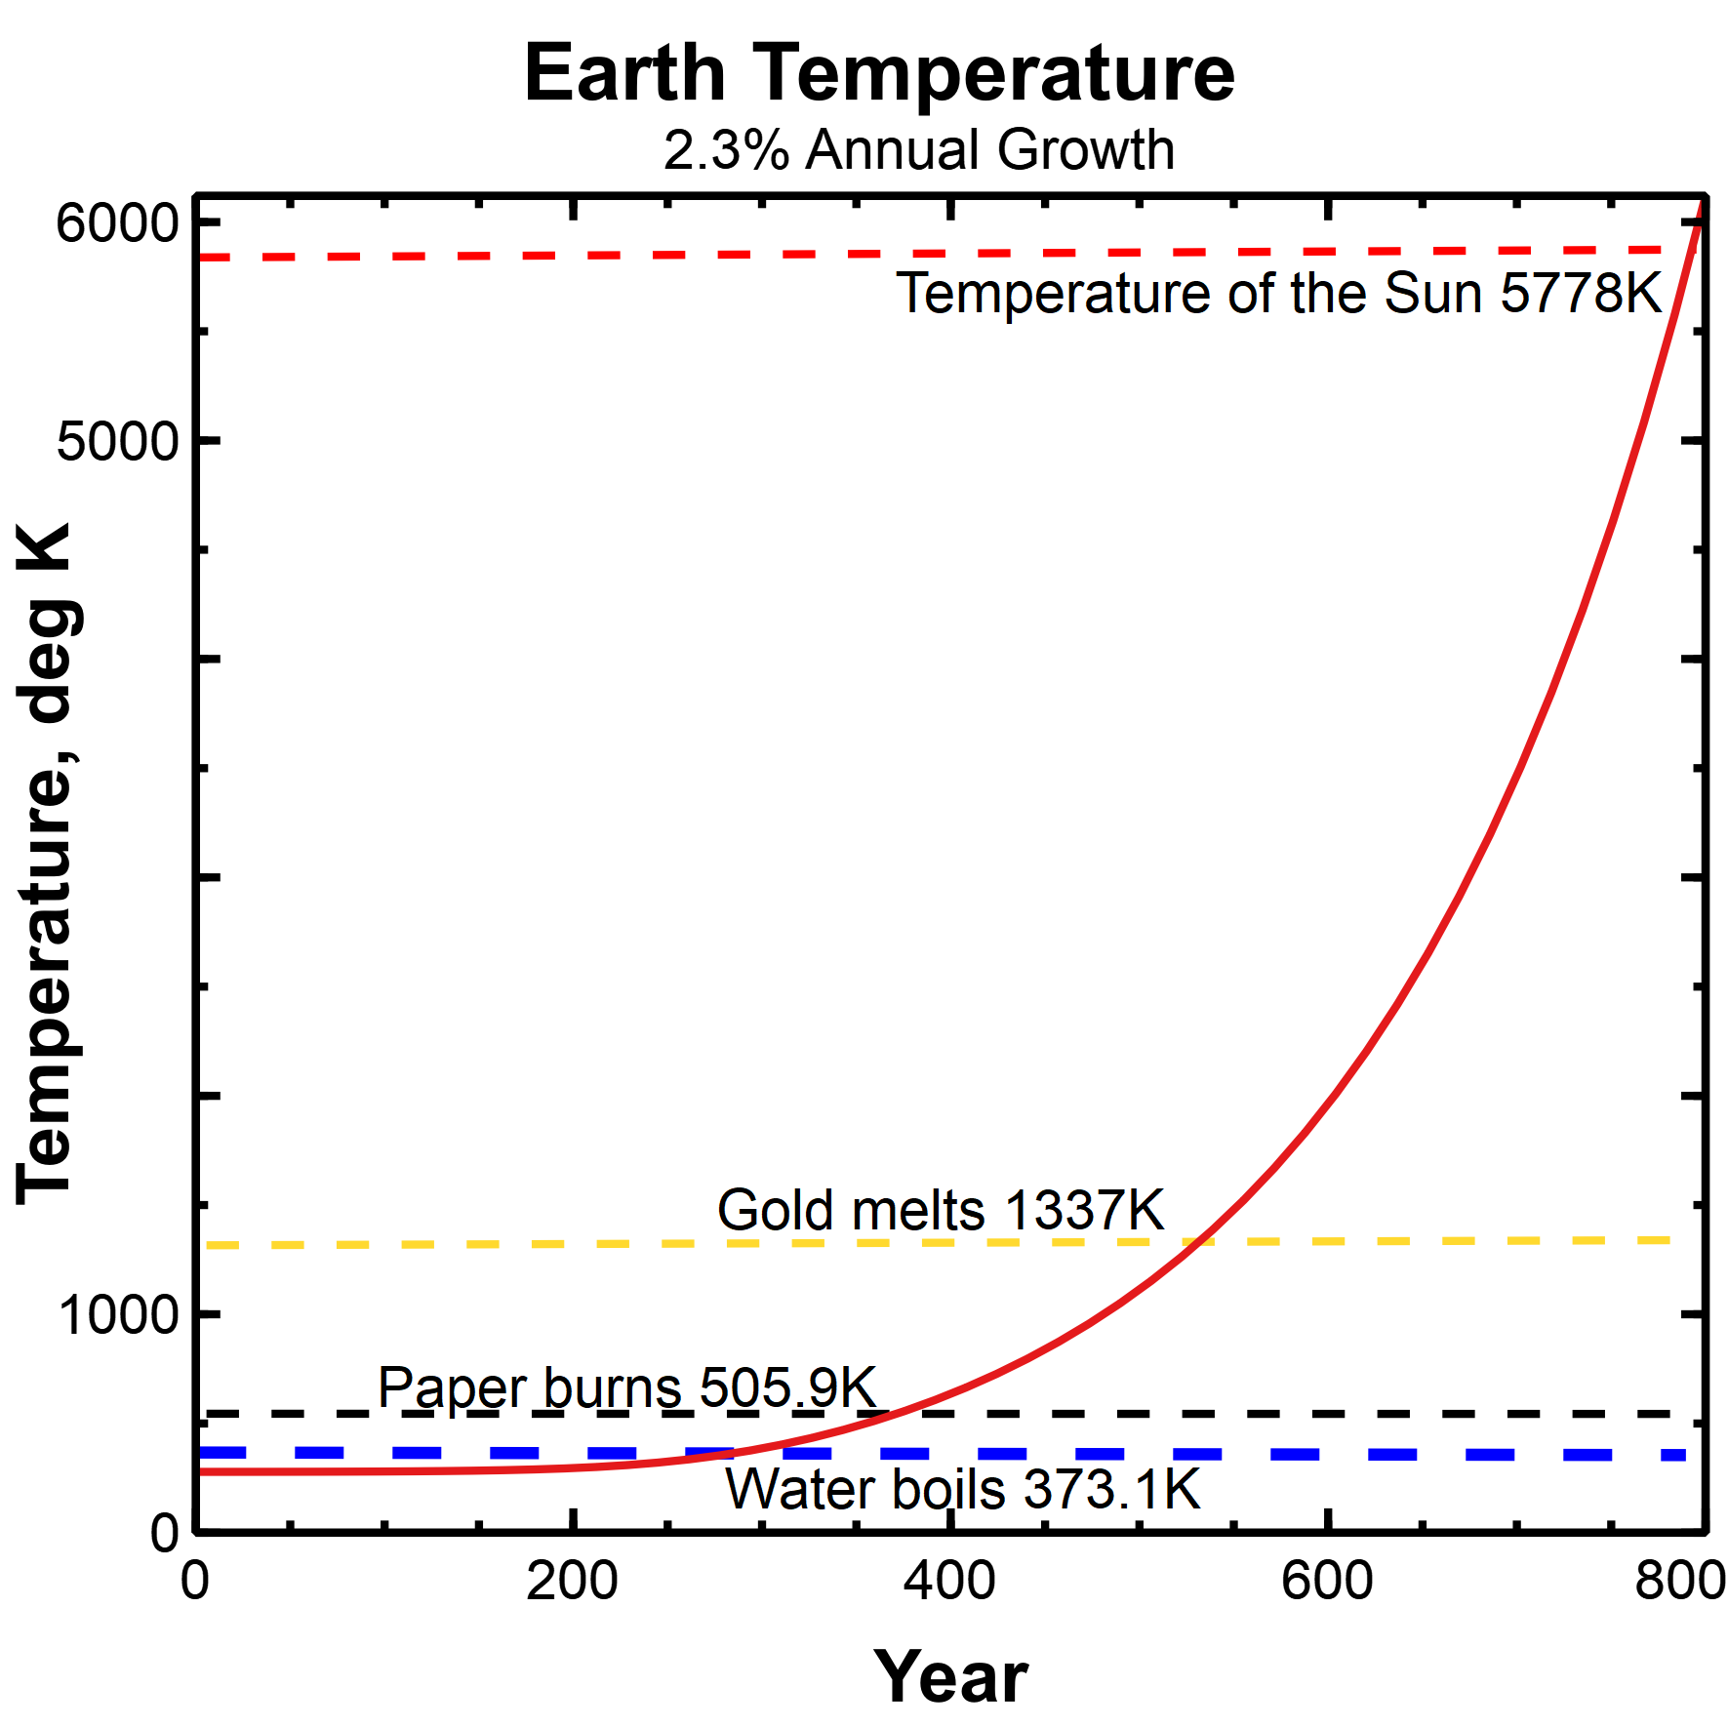
Earth Temperature due to Economic Growth
Use low entropy energy input
Extract wealth
Reject high entropy waste heat
Radiation is only path for energy rejection
2.3% / year = 10 x per century
Strict upper bound on LtG
Ref: “Economics and the Stefan-Boltzmann Law”, J. Peach

Slide 7
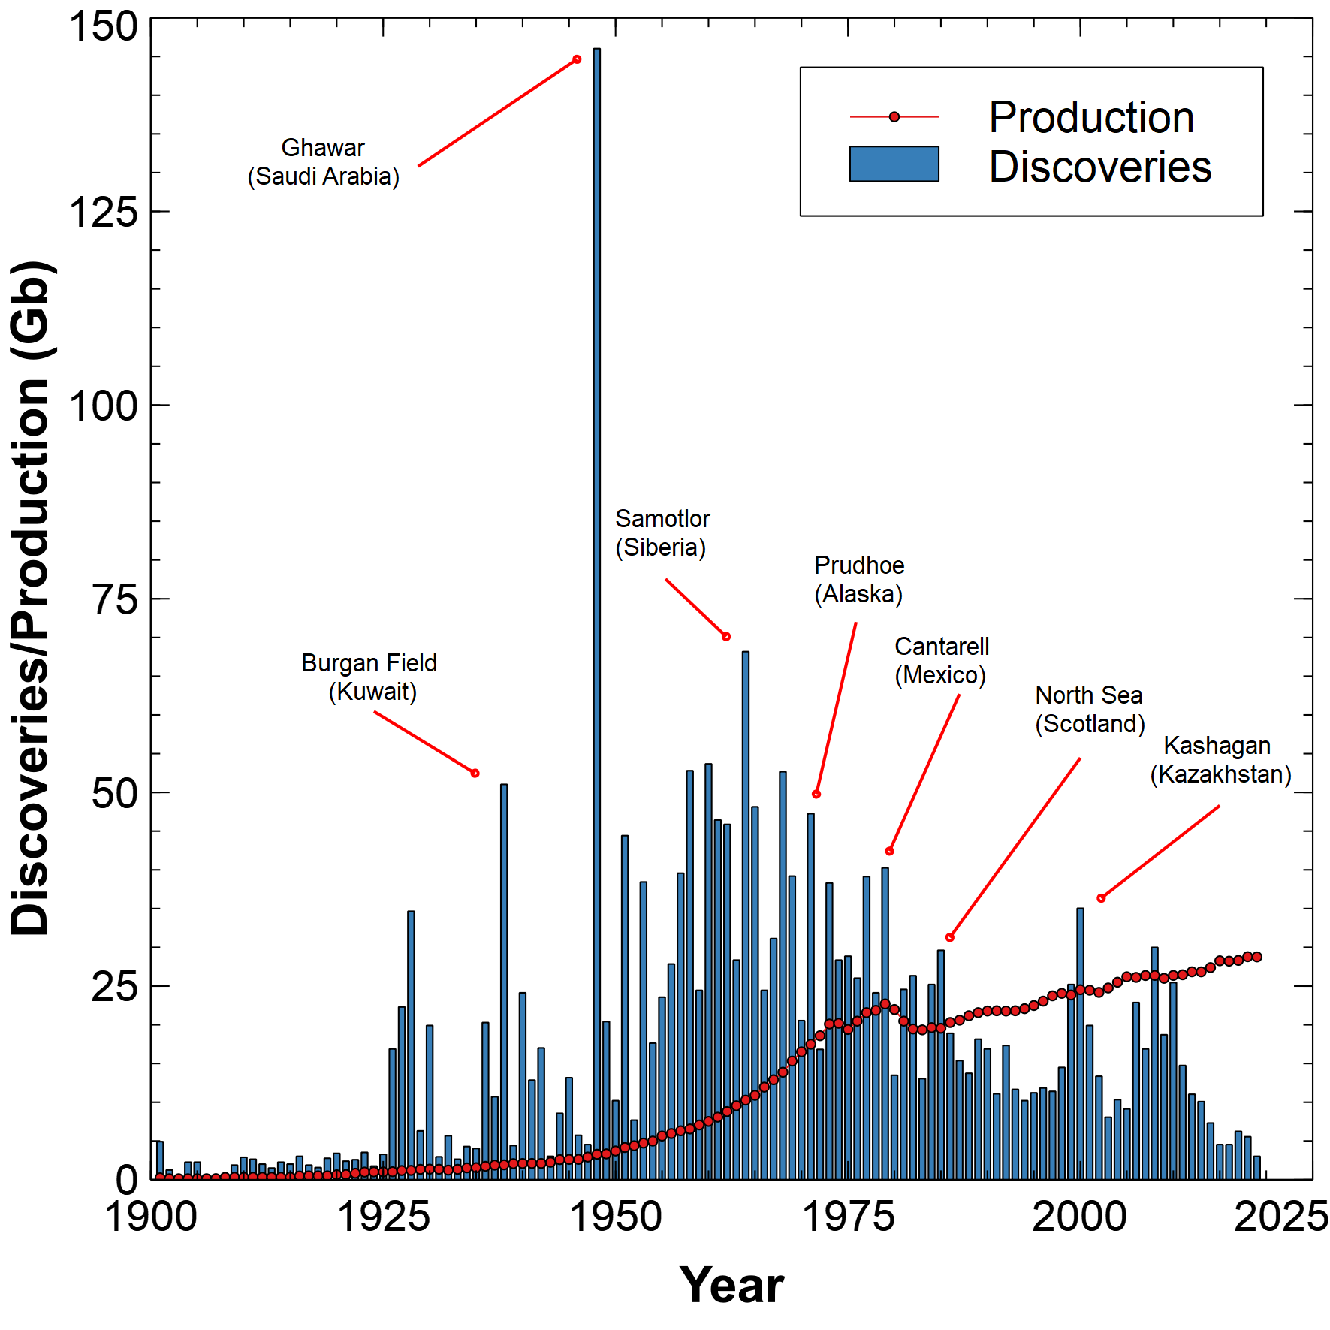

The Growing Gap
Excluding Ghawar, discoveries peaked in 1964
Exponential production growth before 1980
Linear increase since 1980
Production > discovery since 1983 except in 2 years
Ref: “The Growing Gap”, J. Peach

Slide 8
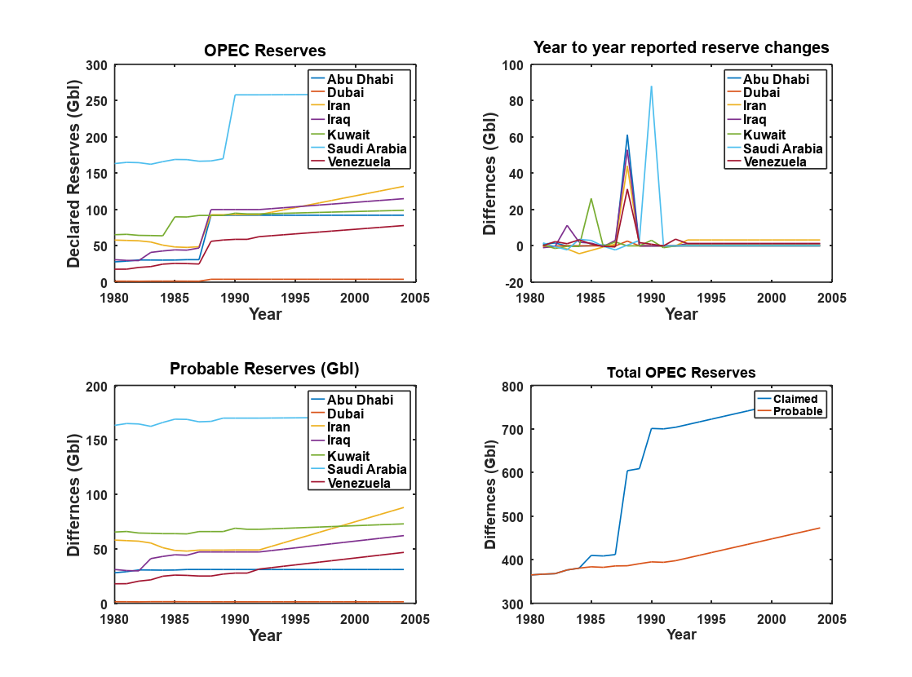
OPEC Reserves Adjustments
Mid-80s OPEC agreement permitted member country production based on reserves
Many members suddenly “found” oil in 1988, Saudis in 1990
Reserves are self-reported
Many countries fail to report, reserve growth assumed to equal production
True world reserves may be >400 Gb less than current estimates

Slide 9
The Three P’s and why they matter
1P = Proven (90% probability of recovery)
2P = Probable (50%)
3P = Possible (10%)
Maximum Likelihood Estimate (MLE) is 2P
Discovery data should be backdated to time of first discovery using 2P estimates of reserves

Slide 10
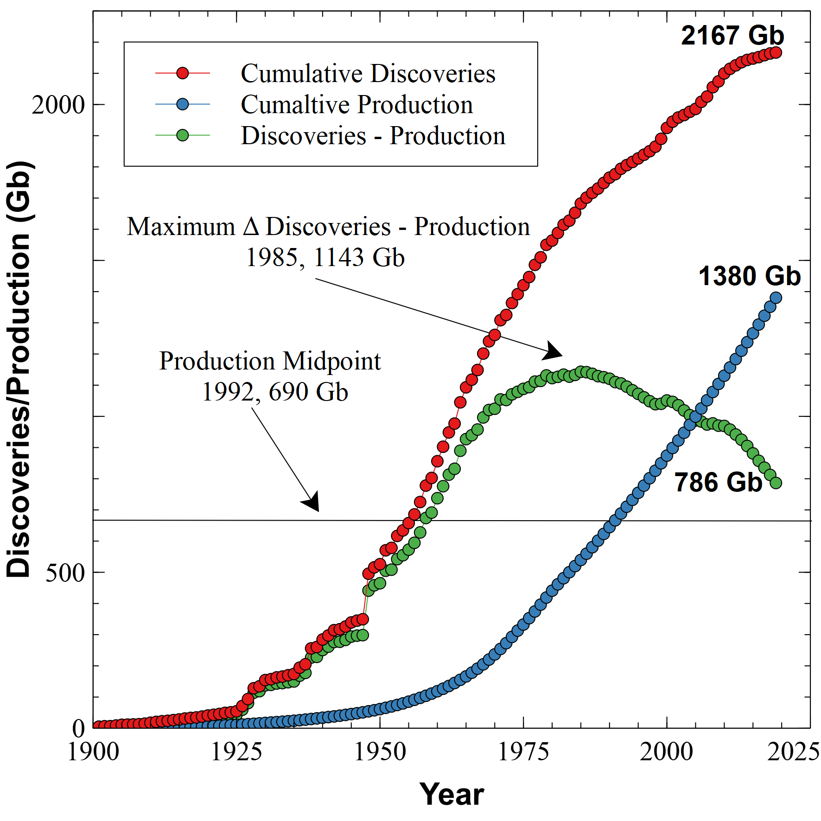
Cumulative Discoveries/Production
Production midpoint in 1992
Half of all oil consumed occurred in last 30 years
Max difference between discoveries and production in 1985
Excludes extra heavy Canadian and Venezuelan tar sands
“Oops all gone” – Saturday August 30th 2053, 6:27 AM UTC (h/t Nils Peterson)

Slide 11
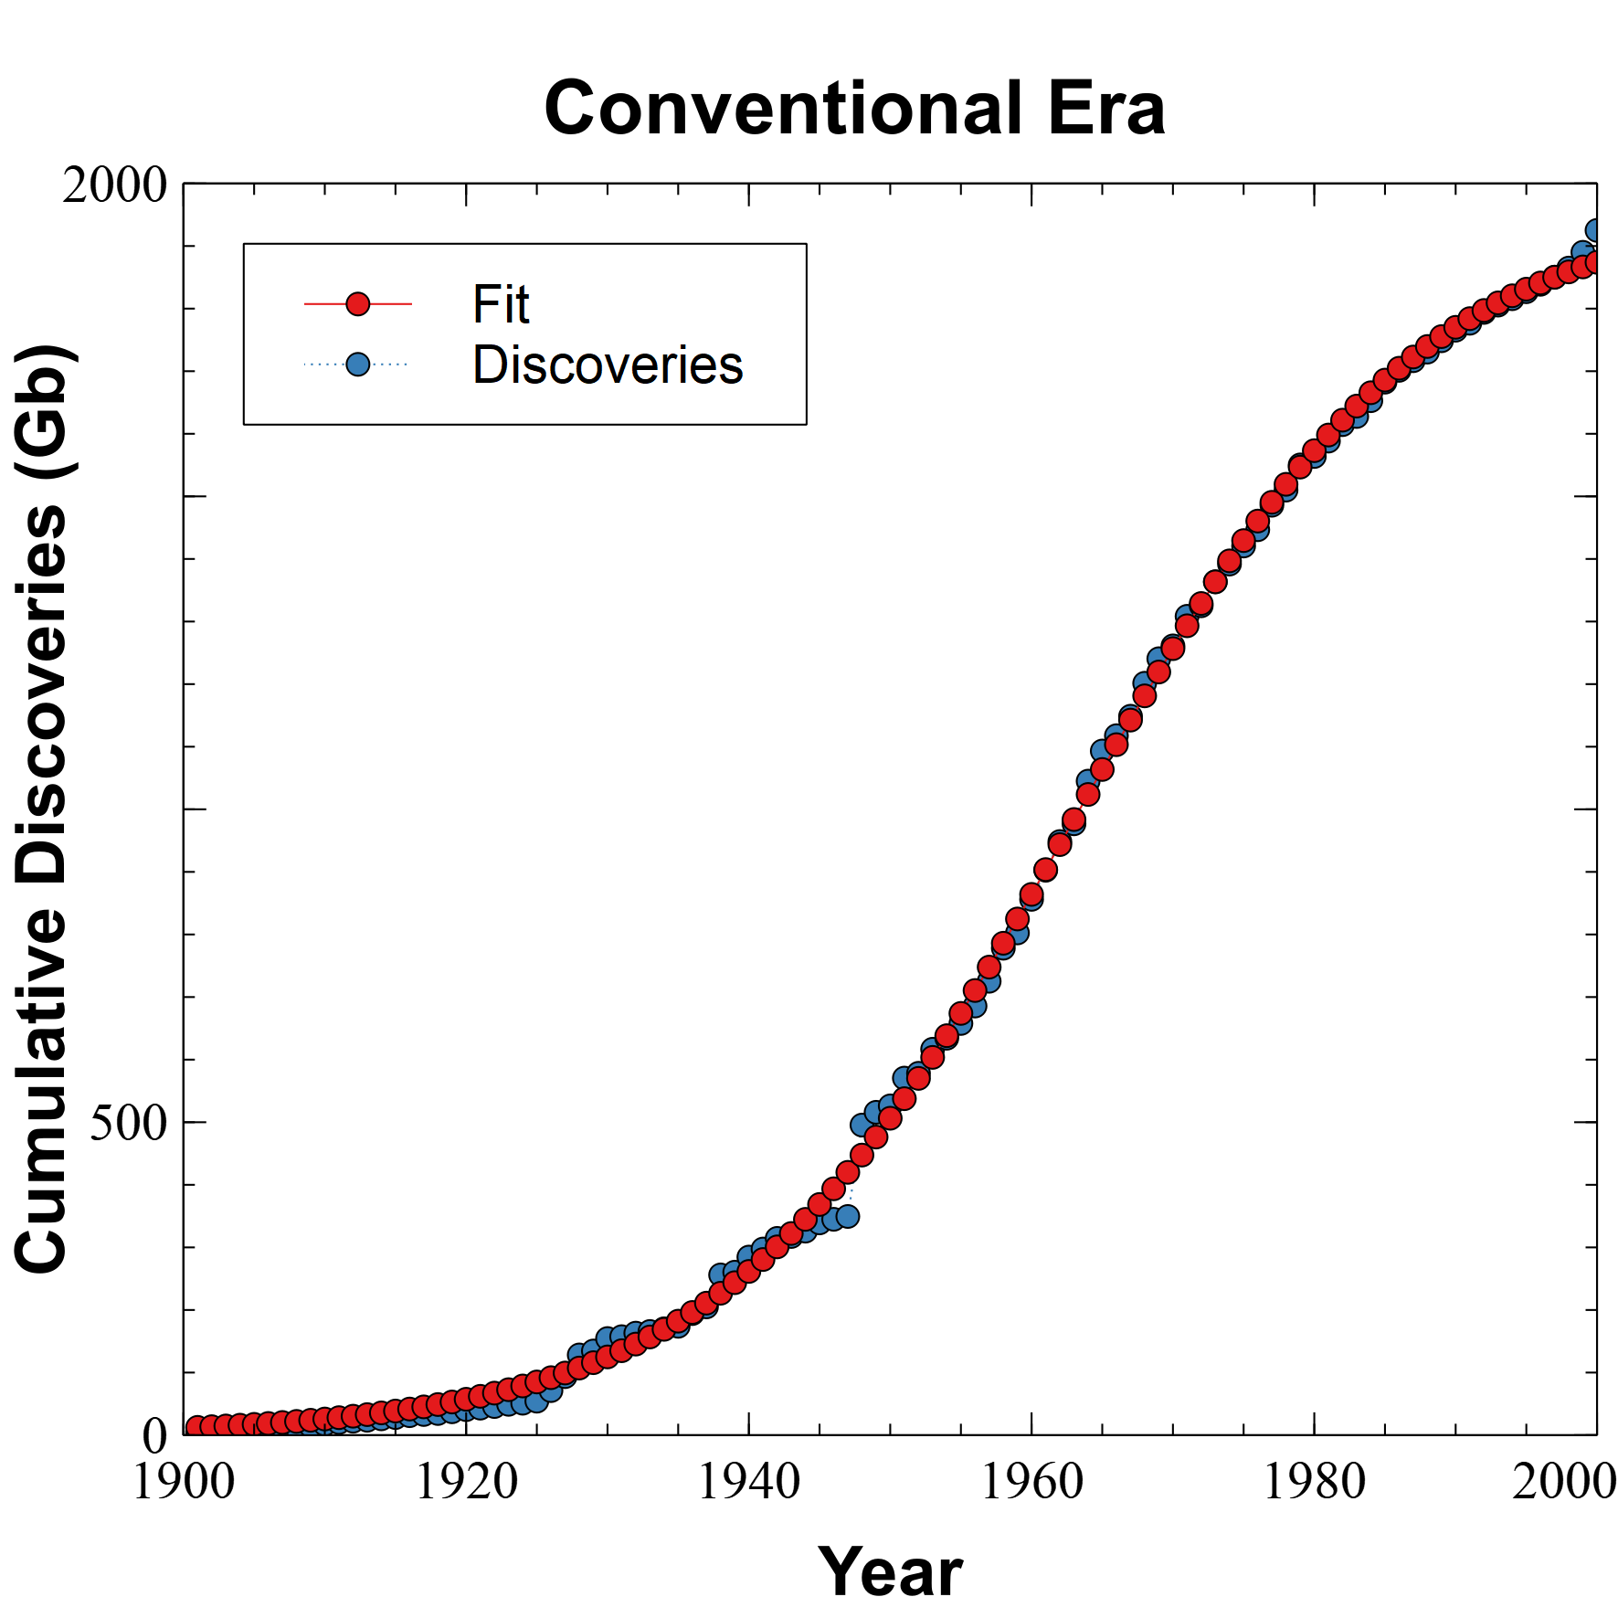
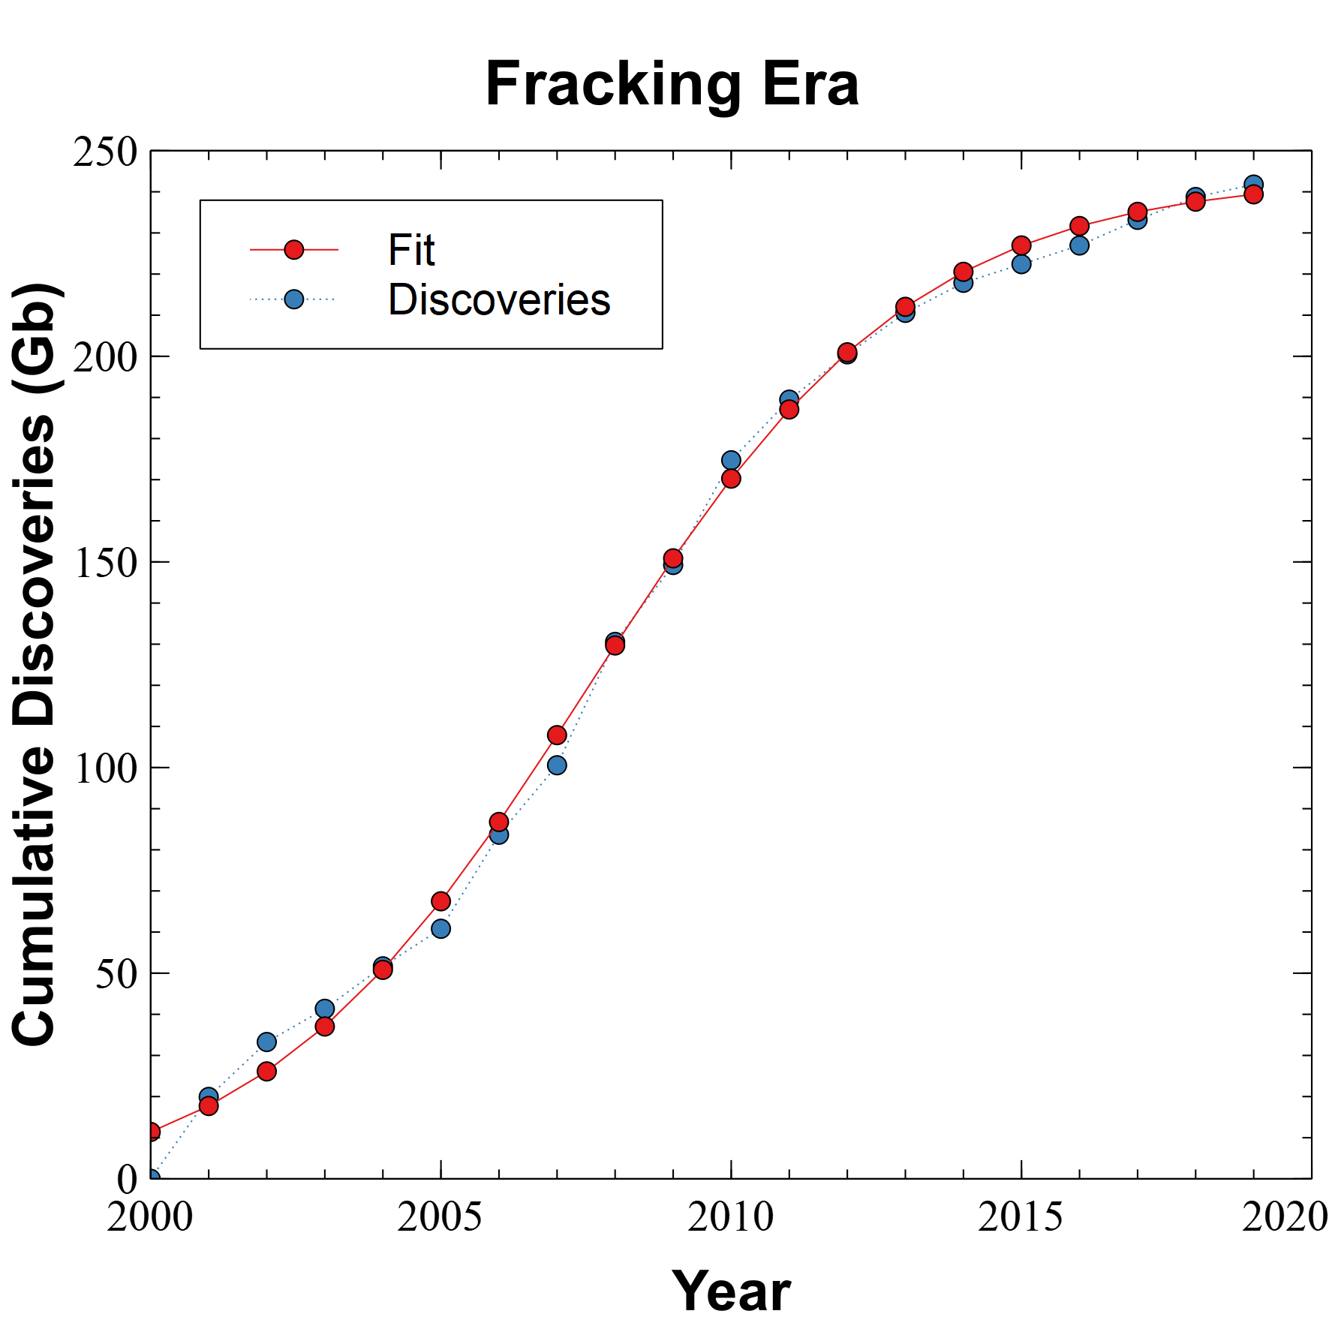
Discovery Data Fitting
Max = 1990 Gb
Max = 250 Gb

Slide 12
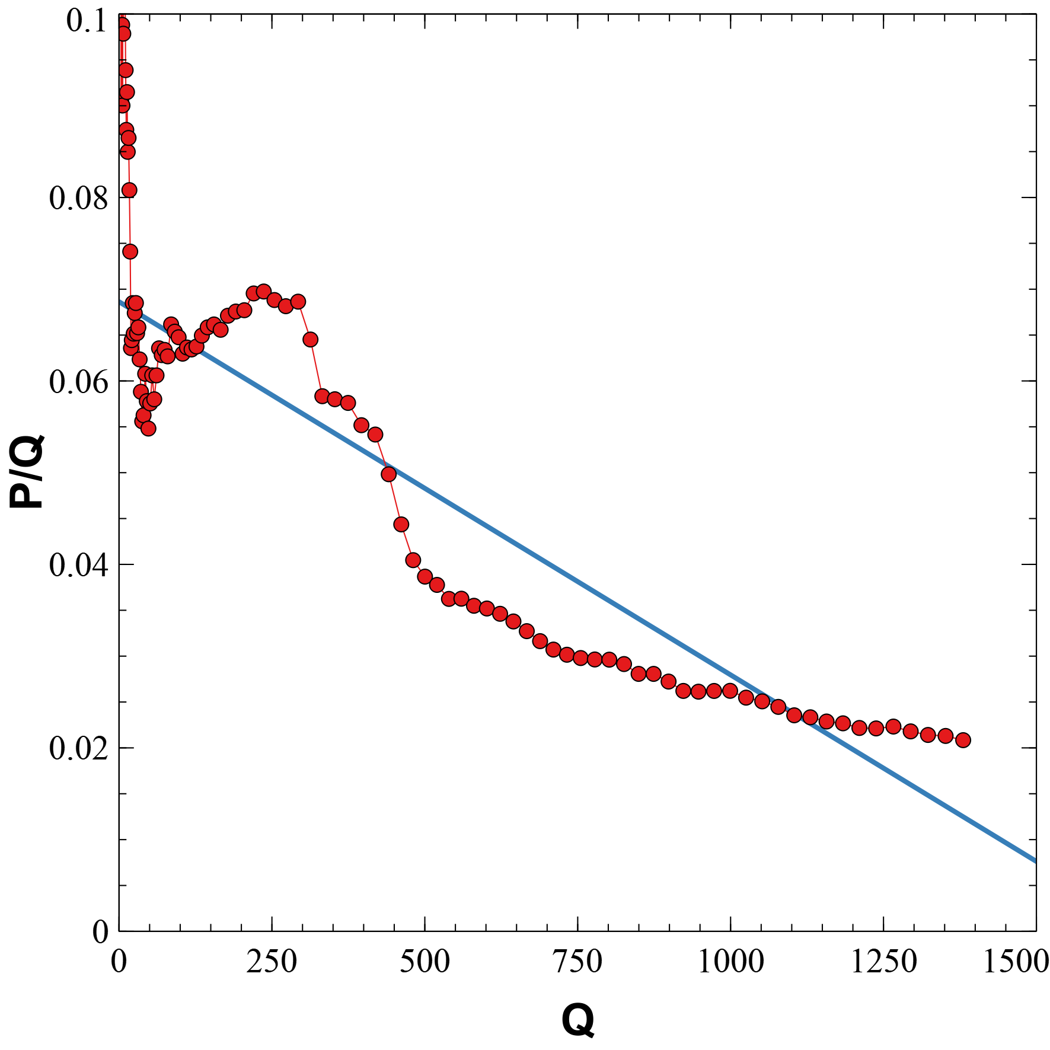
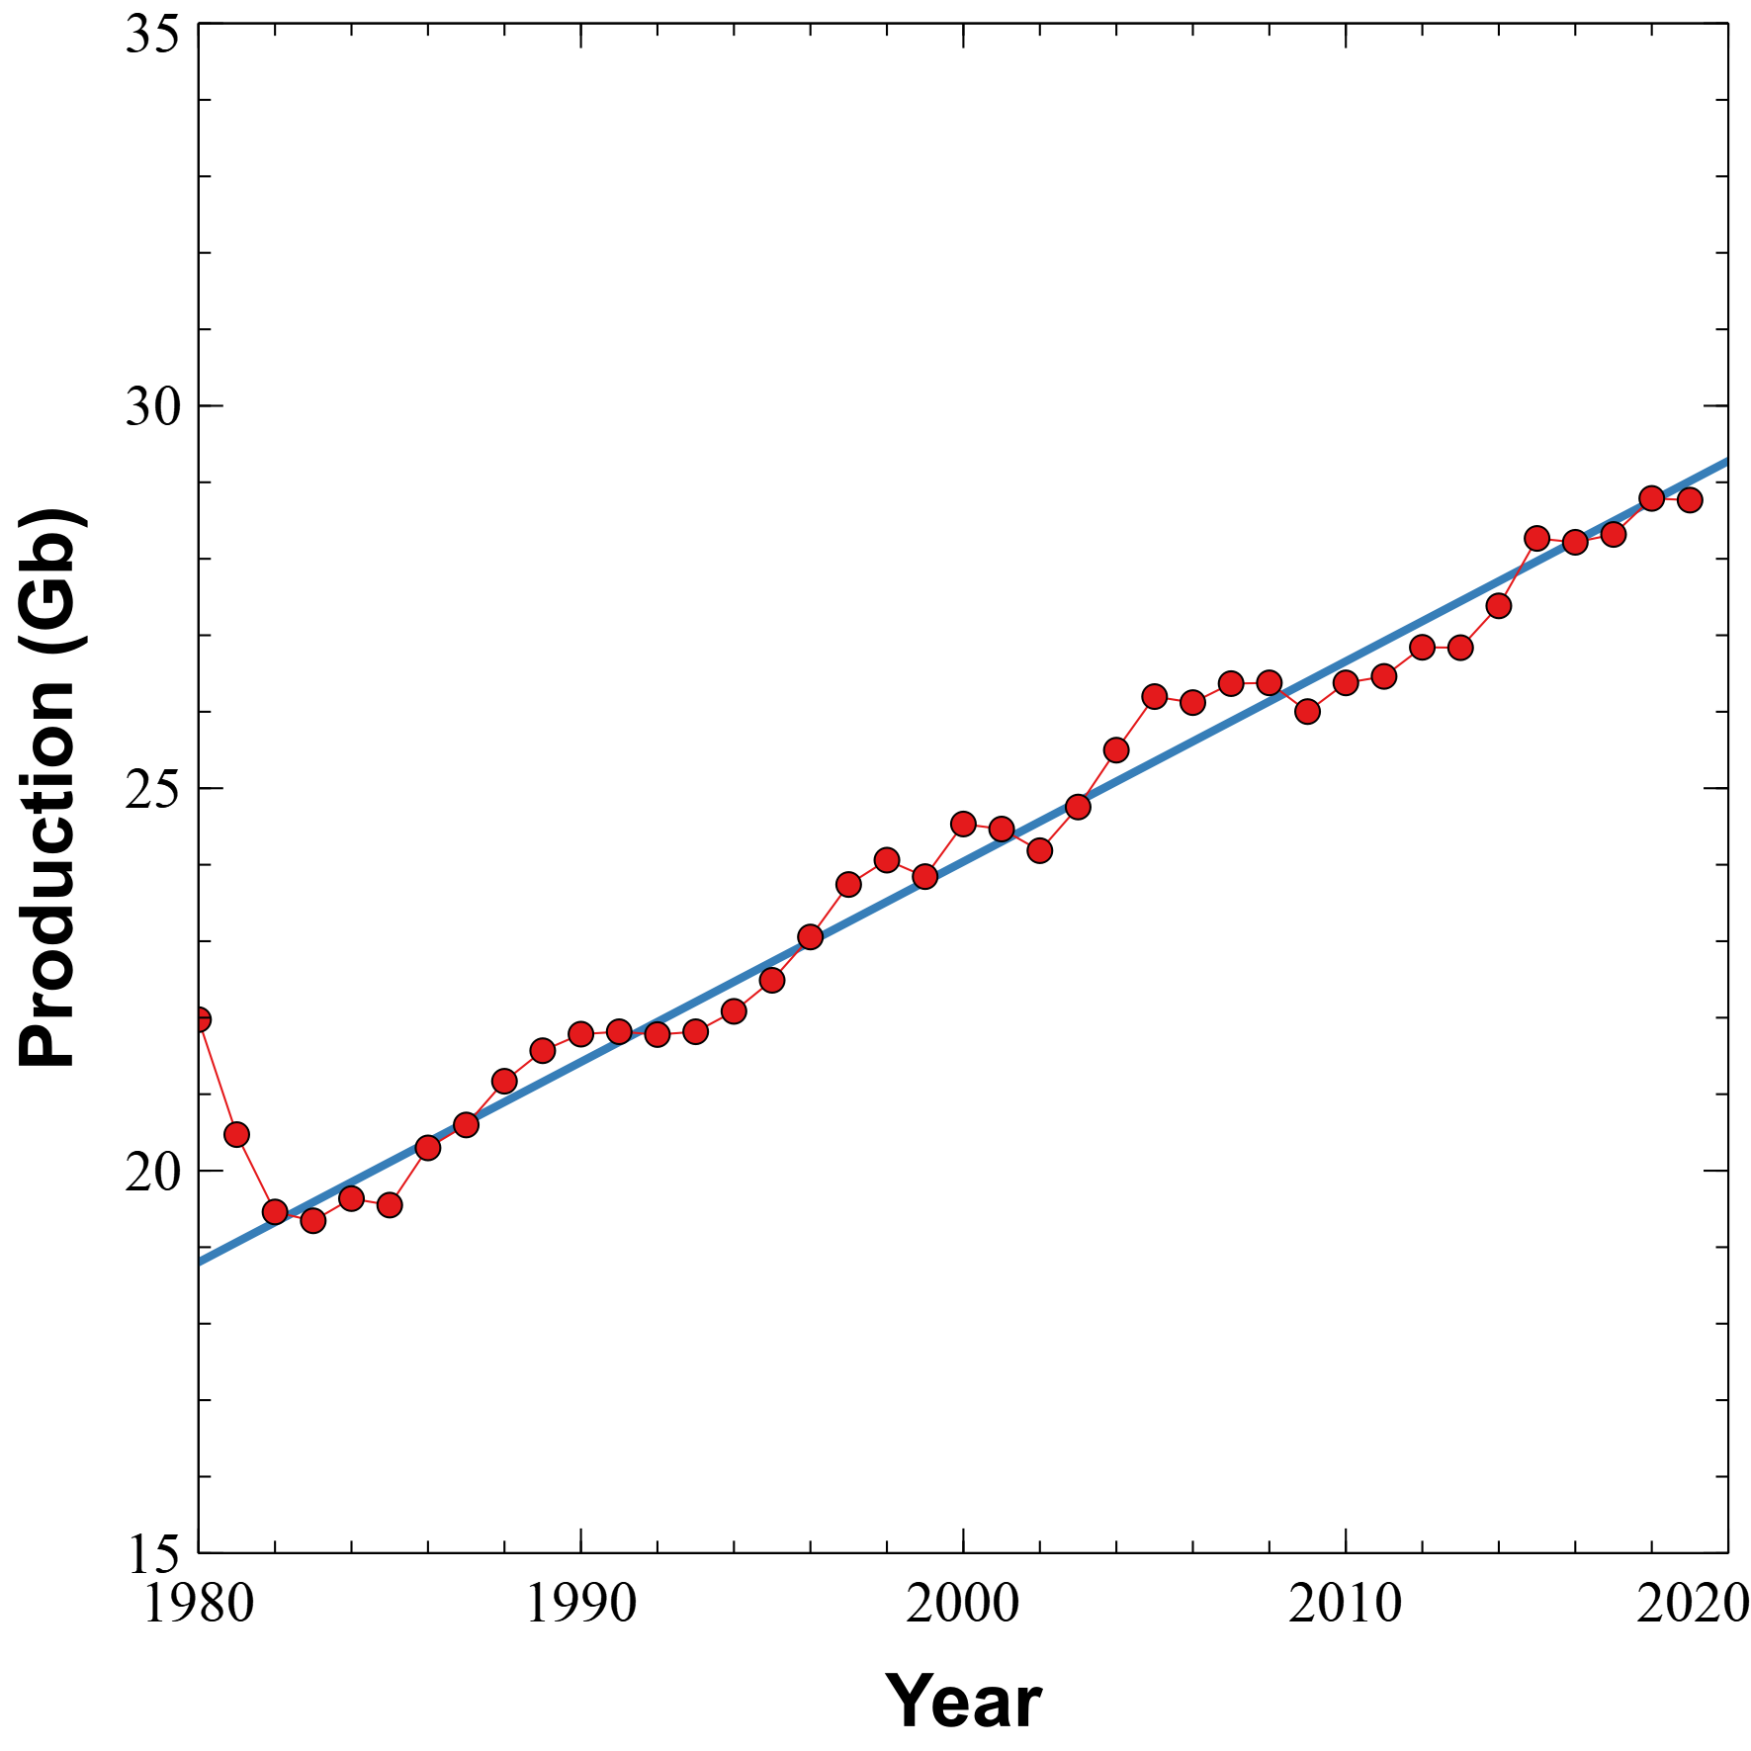
Hubbert Linearization
HL assumes logistic production.
Poor fit to P/Q vs Q shows this
is not happening.
Production is increasing linearly. Hubbert assumed a “tail-off” as nuclear came online.

Slide 13
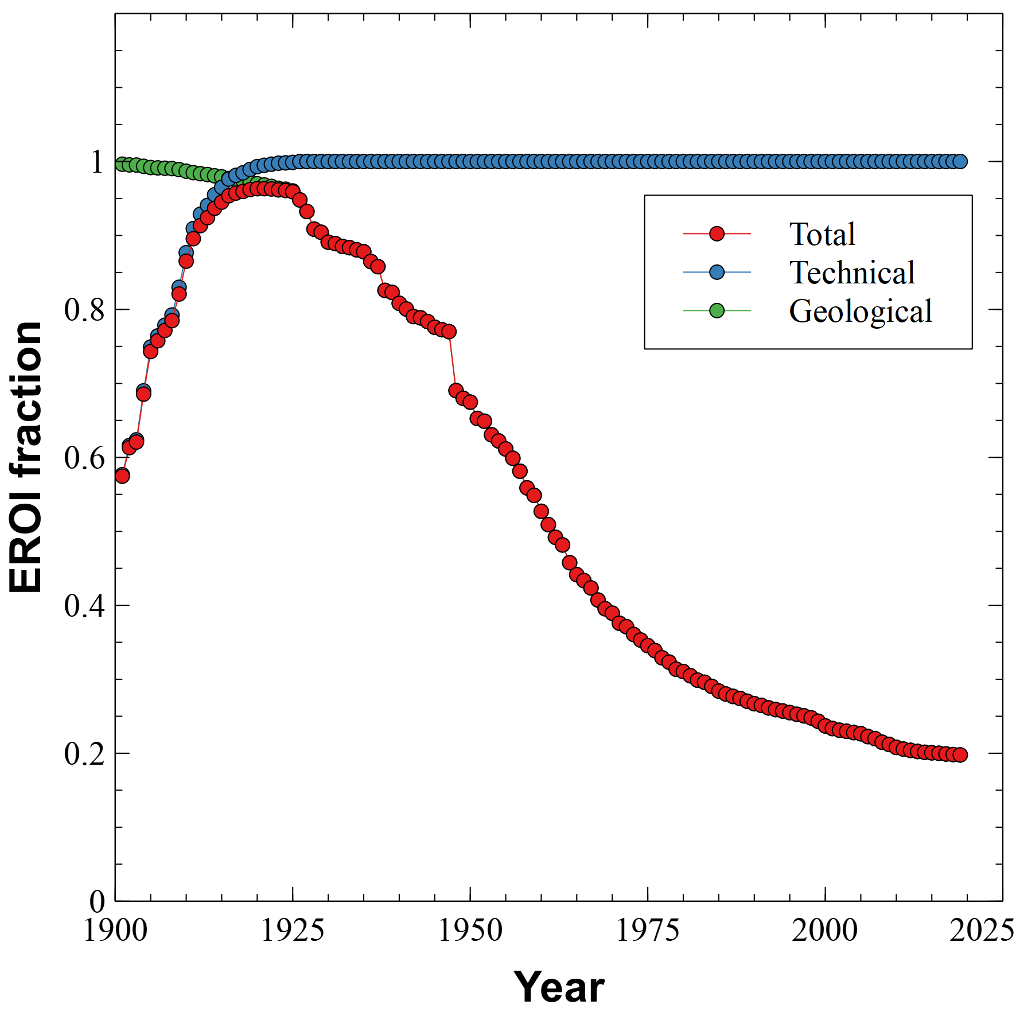
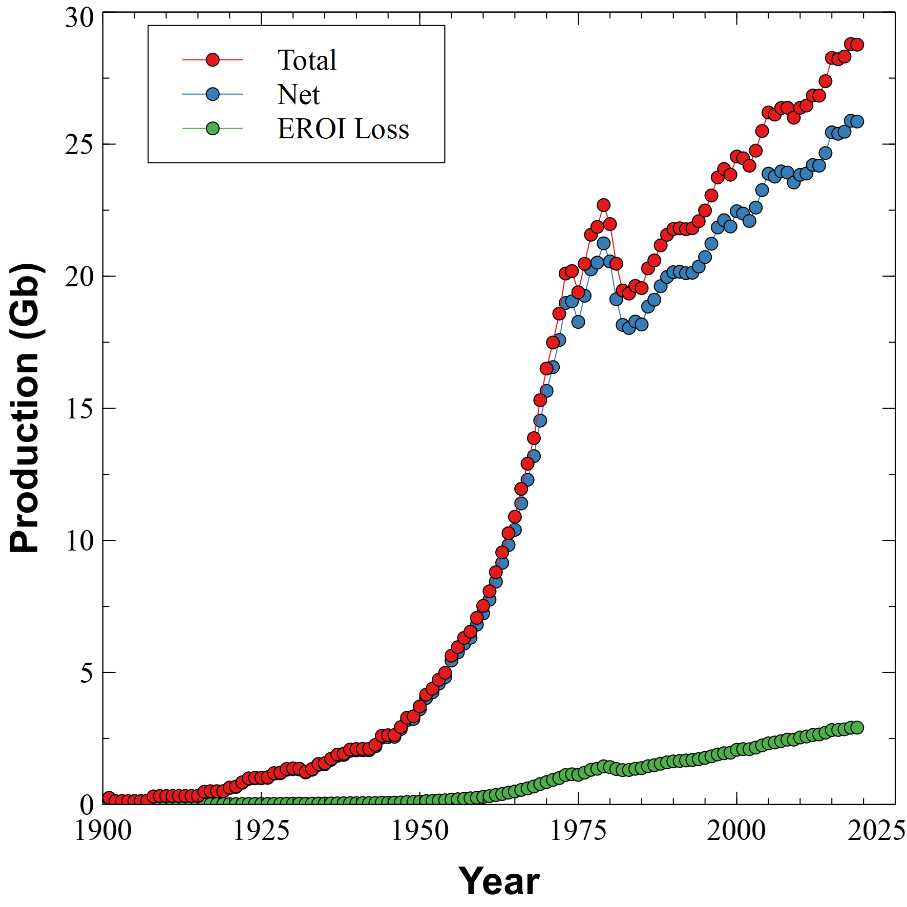
EROI Loss

Slide 14
Questions we should have been asking ourselves
Does the technology exist to successfully transition to a renewable energy economy?
What response from society might we expect?
What might be the impact?

Slide 15

The Sagan Standard
“Extraordinary claims require extraordinary evidence” (ECREE)
Carl Sagan
Demonstrate end-to-end feasibility of manufacture
Show that solar/wind can self-reproduce with sufficient remaining energy to be useful to society (renewable)
Show that at end of useful life all materials can be fully recycled (sustainable)

Slide 16
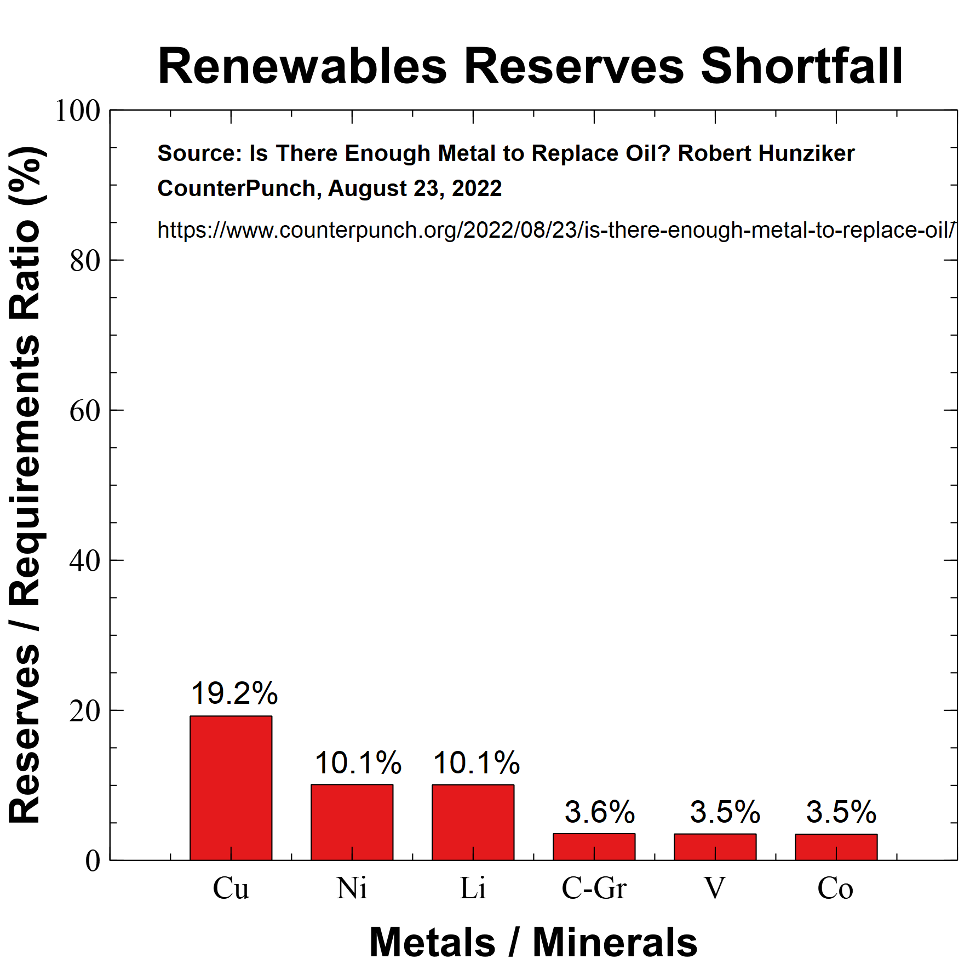
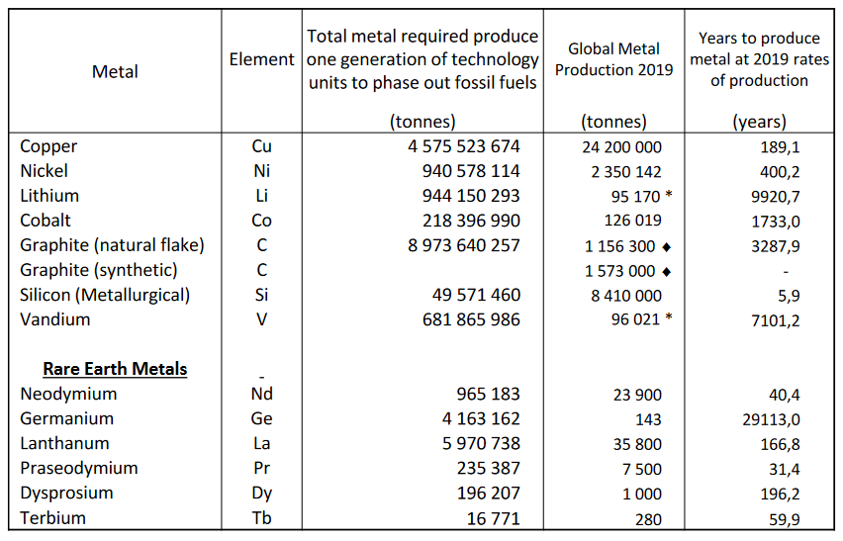
Is a transition possible?
Ref: ASSESSMENTS OF THE PHYSICAL REQUIREMENTS TO
GLOBALLY PHASE OUT FOSSIL FUELS – Simon Michaux
See also: Simon Michaux: “Minerals Blindness”

Slide 17
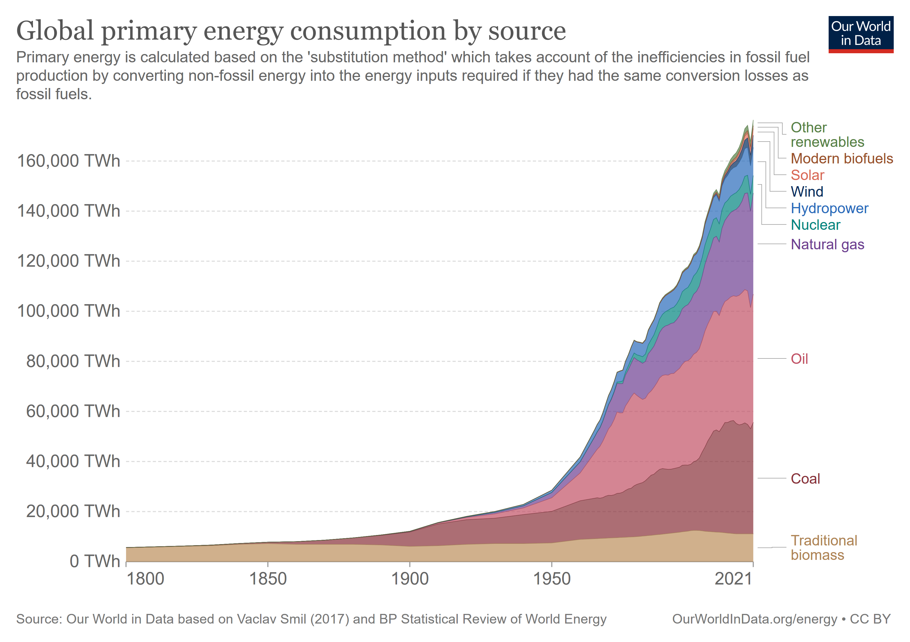
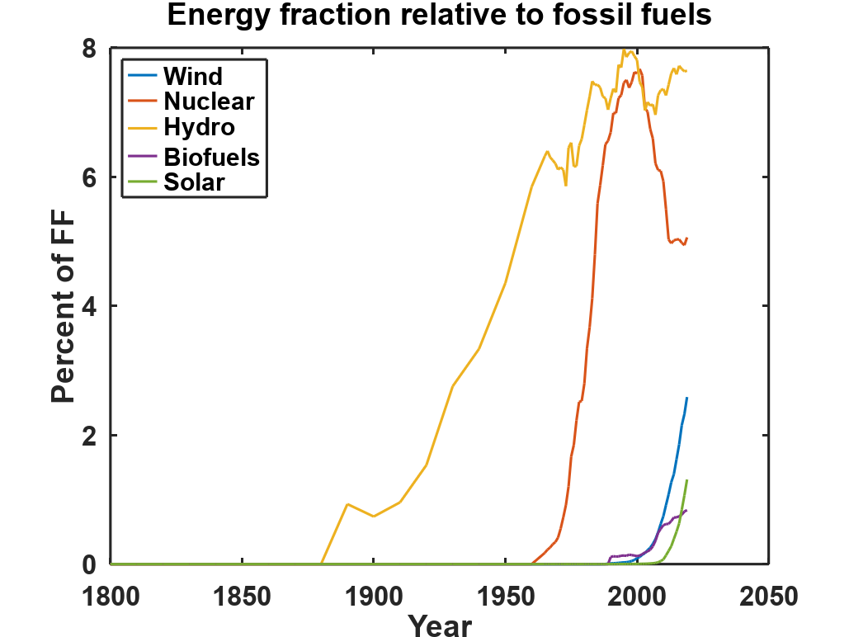
Renewable Energy Additions to Total No evidence of substitution
Increase in nat gas consumption 37% greater than combined solar/wind over previous decade
No evidence of economic degrowth/decoupling

Slide 18
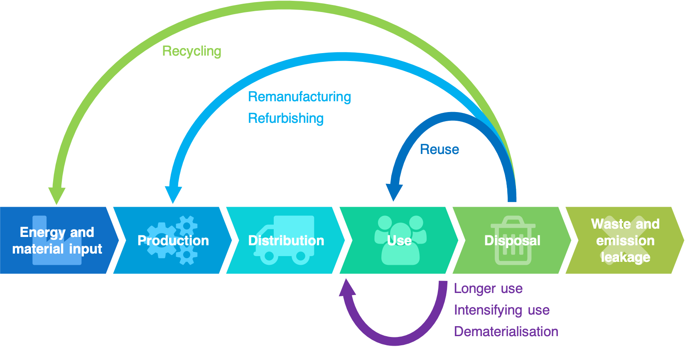
Donut Economics, Circular Economy
For donut economics to take hold, people would have to “magically” become “indifferent to how well we do compared to others, and not really care about wealth and income.”
Branko Milanović,
CUNY Stone Center on Socio-Economic Inequality
Circular Economy (CE) as a proposed solution is a good start but ultimately not a viable replacement in its current form. This is due to the CE not being able to allow for economic growth or human population growth, yet still develop a system based around recycling only. The mining of minerals is considered not relevant as it is to be phased out.
Simon Michaux
Senior Scientist, Geological Survey of Finland
How should we define the terms “renewable” and “sustainable”?

Slide 19

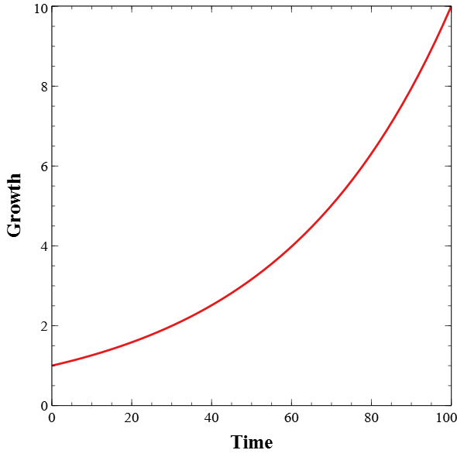
Efficiency Improvements
Annual Growth of 2.3%
2.3% annual growth = order of magnitude (10x) per century
Physical limits to processes:
Carnot cycle
Betz limit
Bandgap limit
Public fails to understand exponential growth, expects increases in salary, wealth
BAU = {1,2,4,8,16,32,64, …}
Eff = {½,1,2,4,8,16,32,64, ...}
Efficiency without degrowth only delays impacts

Slide 20
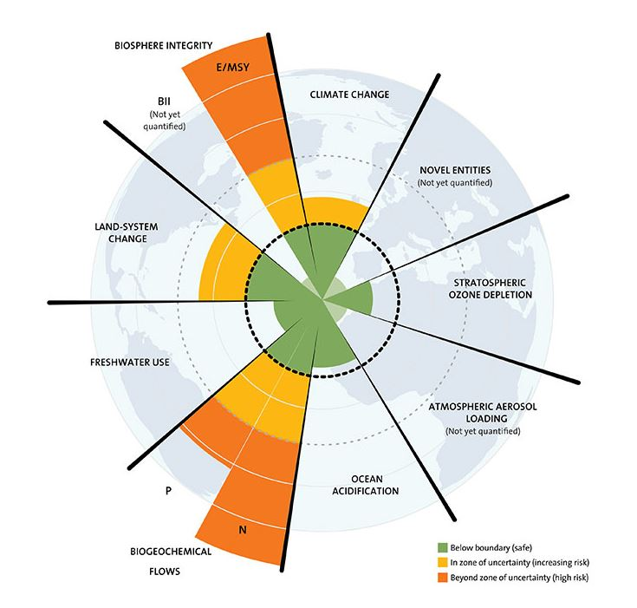
What would happen if we had energy too cheap to meter?
Global Oceanic Environmental Survey
“Throw the earth a Life Line because we have less than 10 years to eliminate pollution, and prevent a cascade failure of the marine ecosystem”
Path to extinction? Sperm count accelerates its decline
Kurt Cobb (h/t The Collapse Chronicle)
Global Dimming Dilemma, Scientists’ Warning
Also: Today’s Contemplation: Collapse Cometh LXXX, Steve Bull
Ref: “The nine planetary boundaries”
Johan Rockström, Will Steffan - Stockholm Resilience Center

Slide 21
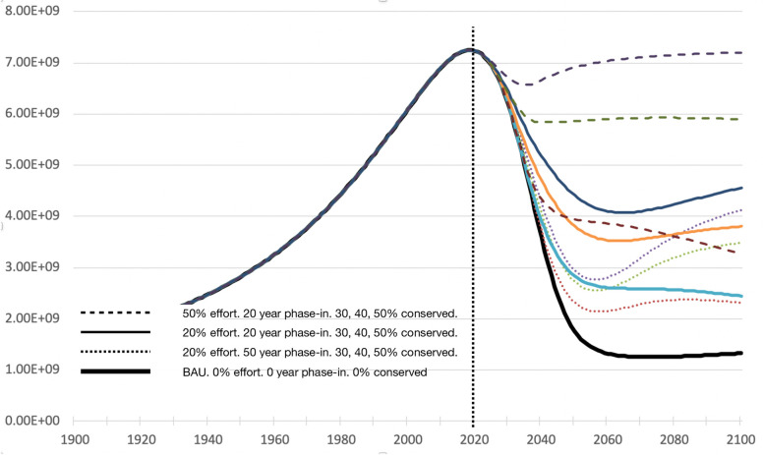

The World 4 Model
Ref: Footprints to singularity: A global population model explains late 20th century slow-down and predicts peak within ten years
Christopher Bystroff – World 4 Model

Slide 22
Summary
Peak oil production may be followed by a “Seneca Cliff”
Economy depends on energy, no evidence of decoupling or donut economics
Cumulative discoveries fit bimodal logistic, max at 2240 Gb (excl. extra heavy)
EROI losses increasing linearly – less available energy for society
Renewable energy transition seems unlikely
No evidence that renewables are self-supporting
No evidence of large scale voluntary move towards degrowth
Failure to understand effects of exponential growth, why conservation is a false promise
Many Earth system boundaries currently being exceeded. Renewable energy only addresses climate change, ocean acidification.
Idea that society “needs” energy has set up false dichotomy between fossil fuels and renewables

